Slide 1
Wolves, Rabbits, and Grass
A presentation of the final project by:
Kamontat Swasdikulavath

Slide 2
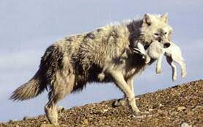
Introduction
For the final project, we have been tasked to create a simulation.
Inspired by learning about ecology in my biology class, I have decided to make a simulation about the predator prey relationship.
More specifically, rabbit and wolves
Image Source: https://schoolwires.henry.k12.ga.us/cms/lib08/GA01000549/Centricity/Domain/7044/wolves%20rabbit%20prey.pdf

Slide 3
Table of contents
The Idea
The Grid base class
The Subclass
The Functions
Demonstration and results
Conclusion

Slide 4

The idea
There is a “World”
The World is a 2D grid.
The grid has 4 different types of available classes, Dirt, Grass, Wolf, and Rabbit
The Dirt does nothing.
The Grass grows and spreads out.
The Rabbit eats the grass, moves around, and spreads out.
The Wolves eats the rabbit, moves around, and spreads out.

Slide 5
The Grid base class
This is the base class.
Main Virtual functions:
Act() = Increases age and decrease Health
Eat()
powerLevel()
Type()
checkHealth()

Slide 6
The SubClass
Grass class
The Grass class can’t move and doesn’t eat
It can’t starve but can die from old age
Rabbit Class
Can move and Eats Grass
Will starve
It can die from old age
Wolf Class
Same as Rabbit Class but eats Rabbit
Dirt Class = Doesn’t do anything

Slide 7
The Function
Main Functions:
Replace = Replaces one coordinate with another pointer.
Populate = allows a grid’s occupant to spread
CheckHieracy = will check if one pointer will replace another
Has 2 separate function will similar function.
MoveAway = Forces the object to move
ptrGenerator

Slide 8
What happens each cycle?
First, we populate
Then we let the animal act.
Last, we move objects.

Slide 9
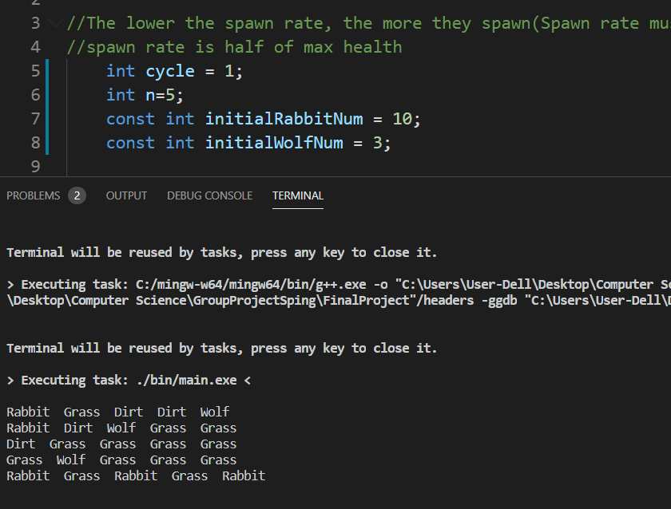
Initialize the world
First, we have a set number of maximum possible wolves and rabbits. Then, every grid has a ¼ chance of placing down a wolf, rabbit, grass or dirt.

Slide 10
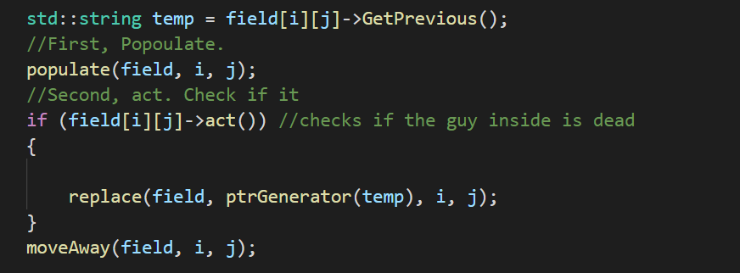
We put the grid in a for loop, and let them go through three phases
1.Populate
2. Act and replace.
3.move.

Slide 11
Populate
Will multiply under 2 condieiotns:
1. spawnrate >0 && (age%spawnrate==0)
2. health >half full health
Populate to random grid around
When this happens, a checkHierachy is called.
Check Hierarchy will check viability, for example.
Grass spread to rabbit = rabbit eats it

Slide 12
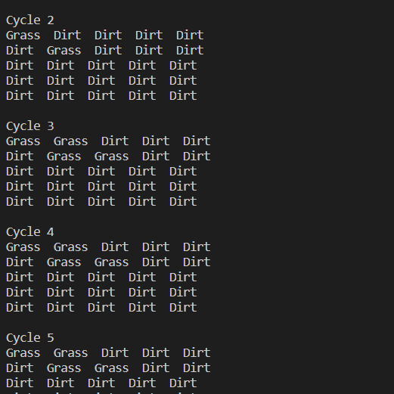
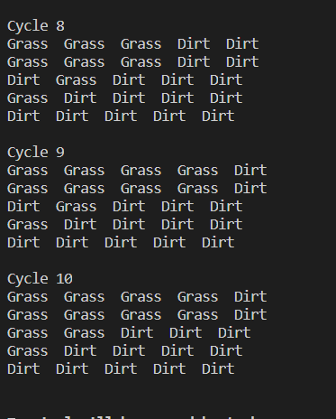
Demonstration

Slide 13
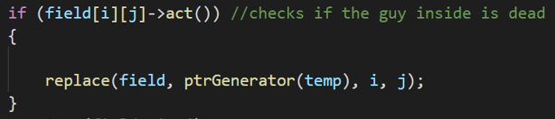
Act and replace
In act and replace, 2 things happen to the pointer’s resident
It’s health decrease by one (for rabbits and wolves)
It’s age increases by one(does not apply for dirt)
If the animal should be dead, it will return a true, which will allow us to kill it.
bool Wolf::act()
{
if(age==FullAge||Health==0){
return true;
}
age++;
Health--;
return false;
}
If it returns a true, it will replace the animal with dirt or grass(depending on its previous occupance)

Slide 14
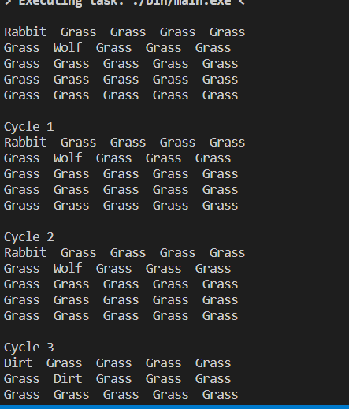
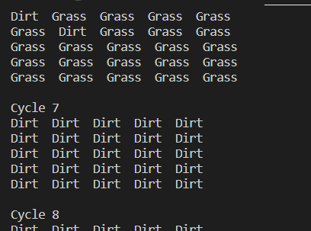
Demonstration(We aren’t making them move or populate)
First, the animals die from a lack of food. (See Cycle 3)
\ Then The grass die from old age
old age

Slide 15
Move
For move, we simply ask the grid’s coordinate occupant to move.
It might move into a prey, and eat it, or move into a predator, and get eaten.

Slide 16
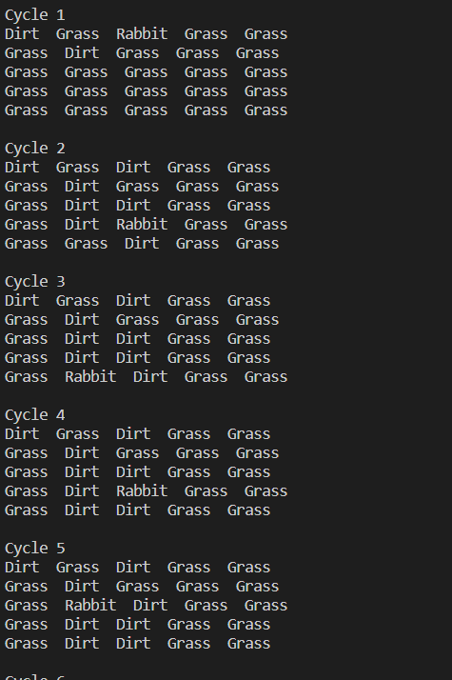
Demonstration
The Rabbit moves around and eats grass

Slide 17
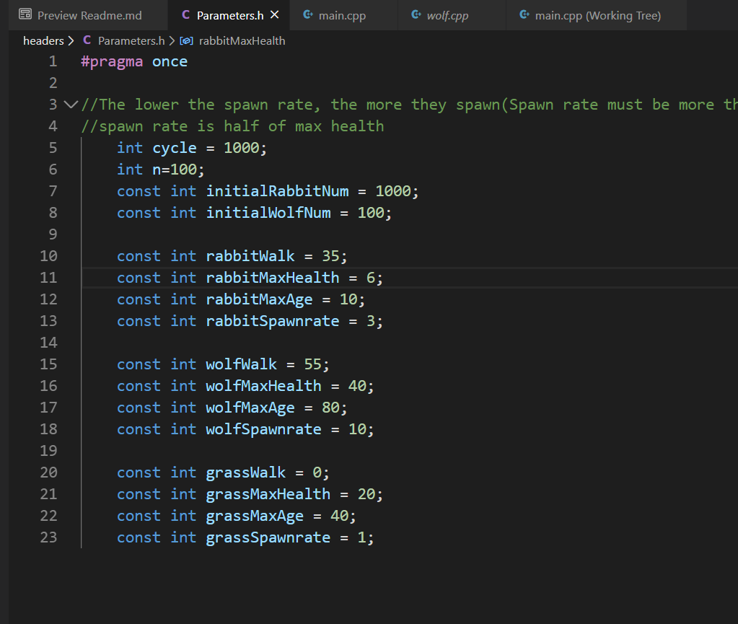
Result
First off, the standard setting.
These are the standard parameters designed to somewhat resemble nature
Wolf lives longer than rabbits. They can also move further and has higher health. (can live longer without food)
Grasses can’t move.

Slide 18
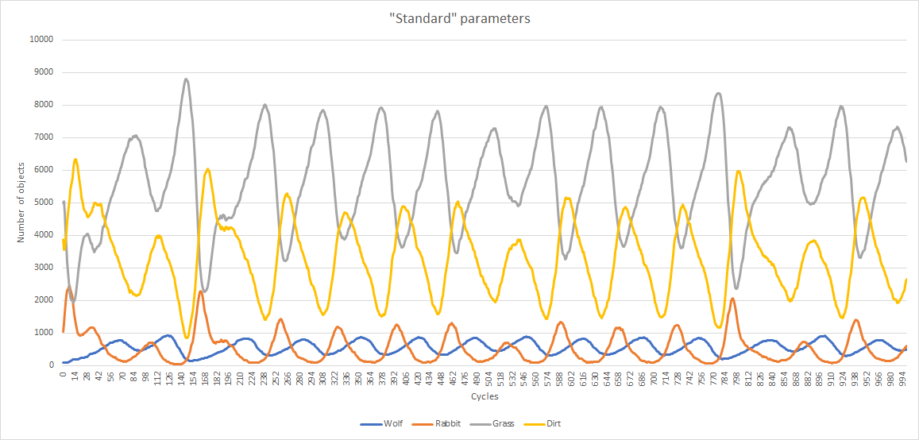
Result of Standard parameters
The number of wolves increase as rabbits decrease
When wolves decrease, rabbits increases!

Slide 19
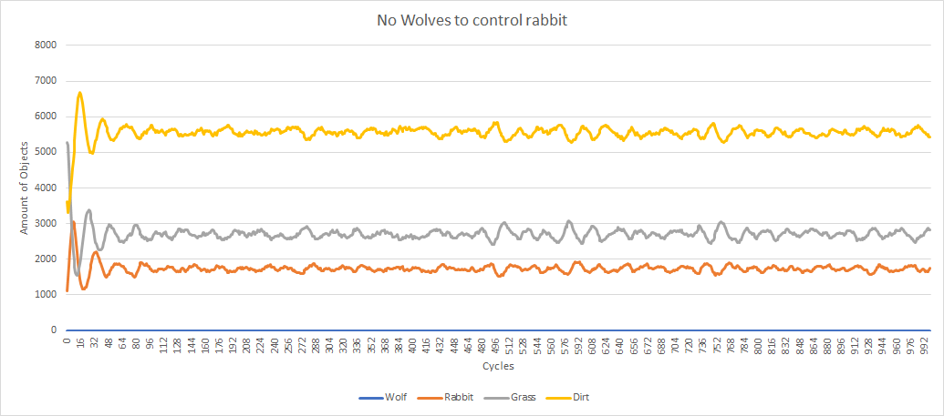
Proof of why Wolves are major controlling factor
Without wolves, the rabbits take over and is always at the carrying capacity. Vegetation can barely grow! It’s now a mostly barren wasteland 90% of the time with nothing to turn it back.

Slide 20
Conclusion
This experiments simulate predator prey relationship in nature
Rabbits, left uncontrolled, eat out more than half of the land with nothing left.
In nature, this would be much worse since grasses will act differently.
Wolves help control the rabbit population.
Without wolves, there are barely any vegetation.
More info in documentation.md!

Slide 21
Major problems
Making of all the functions, how to access world etc
Thankfully, with the help and supervision of the TA, I was able to find a better solution that is used.
Understanding what went wrong each time when a grid is only filled with an empty pointer.
Usually I use a debugger, but if that doesn’t work I take a step back and think through it logically on why it wouldn’t work. Following it step by step.

Slide 22
Thank you!

